Slide 1
Chapter 2-2
The Big Picture

Slide 2
Topics
Case Study: A Student Registration System
Introduction to Relational Databases
Structured Query Language (SQL)
Transactions
1-<number>

Slide 3
Case Study: A Student Registration System
Student Registration System
  Objectives
    Authenticate themselves as users of system
    Register and deregister for courses
    Obtain reports on a particular student’s status
    Maintain information about students and courses
    Enter final grades for courses that a student has completed
  Users
    Registrar, Faculty, and Students
  More details see Chap 14
1-<number>

Slide 4
Relational Databases (RDB)
Databases
  At the heart of most transaction processing systems (TPS)
  The database must contain an accurate description of the real-word enterprise the TPS is modeling
Data is stored in tables
1-<number>

Slide 5
RDB－Table
Set of rows (no duplicates) (STUDENT table)
  Each row describes a different entity (student)
  Each column states a particular fact about each entity (student)
  Each column has an associated domain
    Fig. 2-1: Domain of Status = {fresh, soph, junior, senior}
Id Name Address Status
1111 John 123 Main fresh
2222 Mary 321 Oak soph
1234 Bob 444 Pine soph
9999 Joan 777 Grand senior
Fig. 2-1 The table STUDENT. Each row describes a single student
1-<number>

Slide 6
RDB－Relations and Tuples
Relational model [Codd 1970, 1990]
  Mathematical Relation corresponding to a Table
    Tables in a database can be modeled as mathematical Relation
      Operations on the tables can also be modeled as mathematical operations on the corresponding relations (see next page)
    A Relation: A set of Tuples
      Row ~ Tuple
      Column ~ Attribute
    Values in a tuple are related to each other
      John lives at 123 Main. His Id is 1111. He is a freshman.
  Relation R can be thought of as predicate R
    R(x,y,z) is true iff tuple (x,y,z) is in R
1-<number>

Slide 7
RDB－Operations
Operations on relations are precisely defined
  Take relation(s) as argument, produce new relation as result
    Unary (e.g., delete certain rows)
    Binary (e.g., Union, Cartesian product)
  Corresponding operations defined on tables as well
Using mathematical properties, equivalence can be decided
  Important for query optimization: Query Optimizer
    A complex query against a database might be equivalent to an expression involving many such relational operations involving many relations (tables)
op1(T1,op2(T2)) ≅ op3(op2(T1),T2)
1-<number>

Slide 8
Structured Query Language (SQL)
Language for manipulating tables
  The most commonly used database language
  Declarative – Statement specifies what needs to be obtained, not how it is to be achieved (e.g., how to access data, the order of operations)
DBMS determines evaluation strategy
  This greatly simplifies application programs
  But DBMS is not infallible(絕對有效的)
    Programmers should have an idea of strategies used by DBMS so they can design better tables, indices, statements, in such a way that DBMS can evaluate statements efficiently
1-<number>

Slide 9
SQL－Basic SELECT statements
Project
SELECT <attribute list>
FROM <table list >
WHERE <condition>
Join
Restrict
Language for constructing a new table from argument table(s)
  FROM indicates source tables
  WHERE indicates which rows to retain
    It acts as a filter
  SELECT indicates which columns to extract from retained rows
    Projection
The result is a table
1-<number>

Slide 10
SQL－Example: SELECT statement
SELECT Name
FROM Student
WHERE Id > 4999
Project
Id Name Address Status
1234 John 123 Main fresh
5522 Mary 77 Pine senior
9876 Bill 83 Oak junior
Student
Restrict
Name
Mary
Bill
Result
1-<number>

Slide 11
SQL－More Examples
SELECT Id, Name FROM Student
SELECT Id, Name FROM Student
WHERE Status = ‘senior’
SELECT * FROM Student
WHERE Status = ‘senior’
SELECT COUNT(*) FROM Student
WHERE Status = ‘senior’
All columns (attributes)
result is a table with one column and one row
Aggregate function
1-<number>

Slide 12
SQL－More Complex Example
Multi-table SELECT statements (Join)
  Goal:
    Table in which each row contains the name of a senior, a particular course she took, and the grade she received
  Combines information in two tables:
    Student: Id, Name, Address, Status
    Transcript: StudId, CrsCode, Semester, Grade
SELECT Name, CrsCode, Grade
FROM Student, Transcript
WHERE StudId = Id AND Status = ‘senior’
1-<number>

Slide 13
SQL－Join
T1
T2
SELECT a1, b1
FROM T1, T2
WHERE a2 = b2
a1 a2 a3
A 1 xxy
B 17 rst
b1 b2
3.2 17
4.8 17
a1 a2 a3 b1 b2
A 1 xxy 3.2 17
A 1 xxy 4.8 17
B 17 rst 3.2 17
B 17 rst 4.8 17
FROM T1, T2
yields:
WHERE a2 = b2
yields:
B 17 rst 3.2 17
B 17 rst 4.8 17
SELECT a1, b1
yields result:
B 3.2
B 4.8
1-<number>

Slide 14
SQL－Modifying Tables
UPDATE Student
SET Status = ‘soph’
WHERE Id = 111111111
INSERT INTO Student (Id, Name, Address, Status)
VALUES (999999999, ‘Bill’, ‘432 Pine’, ‘senior’)
DELETE FROM Student
WHERE Id = 111111111
1-<number>

Slide 15
SQL－Creating Tables
CREATE TABLE Student (
Id INTEGER,
Name CHAR(20),
Address CHAR(50),
Status CHAR(10),
PRIMARY KEY (Id) )
Constraint: explained later
1-<number>

Slide 16
Transactions 1
  Many enterprises use databases to store information about their state
    E.g., balances of all depositors
  A transaction is a program that accesses the database in response to real-world events
  The occurrence of a real-world event that changes the enterprise state requires the execution of a program that changes the database state in a corresponding way
    E.g., balance must be updated when you deposit
1-<number>

Slide 17
Transactions 2
Transactions are not just ordinary programs
Additional requirements are placed on transactions (and particularly their execution environment) that go beyond the requirements placed on ordinary programs.
  Atomicity
  Consistency
  Isolation
  Durability
ACID properties
(explained next)
1-<number>

Slide 18
Transactions－Atomicity
A real-world event either happens or does not happen.
  Student either registers or does not register.
Similarly, the system must ensure that either the transaction runs to completion (commits) or, if it does not complete, it has no effect at all (aborts).
  This is not true of ordinary programs. A hardware or software failure could leave files partially updated.
1-<number>

Slide 19
Transactions－Consistency 1
Integrity Constraints
  Rules of the enterprise generally limit the occurrence of certain real-world events.
    Student cannot register for a course if current number of registrants = maximum allowed
  Correspondingly, allowable database states are restricted.
    cur_reg <= max_reg
  These limitations are expressed as integrity constraints, which are assertions that must be satisfied by the database state.
1-<number>

Slide 20
Transactions－Consistency 2
Transaction designer must ensure that
  IF the database is in a state that satisfies all integrity constraints when execution of a transaction is started
  THEN when the transaction completes:
    All integrity constraints are once again satisfied (constraints can be violated in intermediate states)
    New database state satisfies specifications of transaction
1-<number>

Slide 21
Transactions－Durability
The system must ensure that once a transaction commits its effect on the database state is not lost in spite of subsequent failures.
  Not true of ordinary systems. For example, a media failure after a program terminates could cause the file system to be restored to a state that preceded the execution of the program.
1-<number>

Slide 22
Transactions－Isolation 1
Deals with the execution of multiple transactions concurrently.
Serial transaction execution
  If the initial database state is consistent and accurately reflects the real-world state, then the serial (one after another) execution of a set of consistent transactions preserves consistency.
  But serial execution is inadequate from a performance perspective.
1-<number>

Slide 23
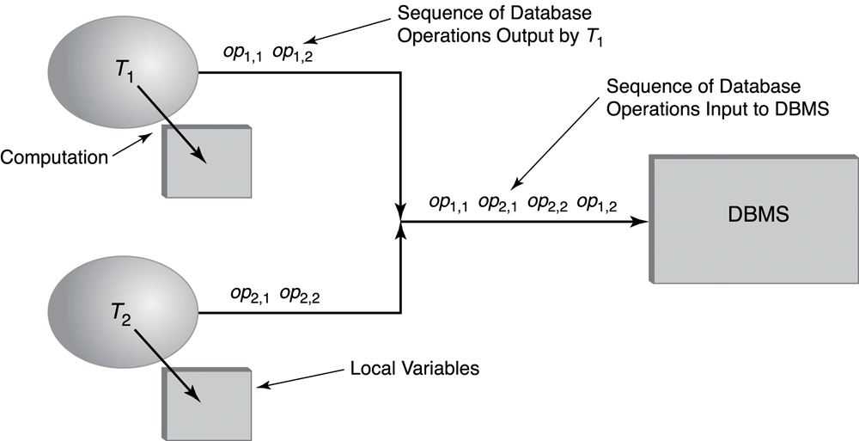
Transactions－Isolation 2
Concurrent transaction execution
1-<number>

Slide 24
Transactions－Isolation 3
Concurrent (interleaved) execution of a set of transactions offers performance benefits, but might not be correct.
  Example: Two students execute the course registration transaction at about the same time
  (cur_reg is the number of current registrants)
T₁: read(cur_reg : 29) write(cur_reg : 30)
T₂: read(cur_reg : 29) write(cur_reg : 30)
time
A B C D
Result: Database state (cur_reg : 30) no longer corresponds to
real-world state (cur_reg : 31), integrity constraint violated.
1-<number>

Slide 25
Transactions－Isolation 4
The effect of concurrently executing a set of transactions must be the same as if they had executed serially in some order
  The execution is thus not serial, but Serializable
Serializable execution has better performance than serial, but performance might still be inadequate
  Database systems offer several isolation levels with different performance characteristics (but some guarantee correctness only for certain kinds of transactions – not in general)
1-<number>

Slide 26
Transactions－ACID Properties
The TP monitor is responsible for ensuring atomicity, durability, and (the requested level of) isolation.
  Hence it provides the abstraction of failure-free,
  non-concurrent environment, greatly simplifying the task of the transaction designer.
The transaction designer is responsible for ensuring the consistency of each transaction, but doesn’t need to worry about concurrency and system failures.
1-<number>

